Slide 1
Local Search
Prepared by
Dr. Aliya Aleryani

Slide 2
Outlines
Local Search and Optimization Problems
Terminologies
Hill Climbing Algorithm
Examples
Hill Climbing Pros/Cons
Hill Climbing Types
Simulated Annealing

Slide 3
Local Search and Optimization Problems
Local Search algorithms operate by searching from a start state to neighbouring states, without keeping track of the paths, nor the set of states that have been reached.
might never explore a portion of the search space where a solution actually resides.
solve optimization problems, in which the aim is to find the best state according to an objective function.
Key advantages:
use very little memory
often find reasonable solutions in large or infinite state spaces for where systematic algorithms are unsuitable.

Slide 4
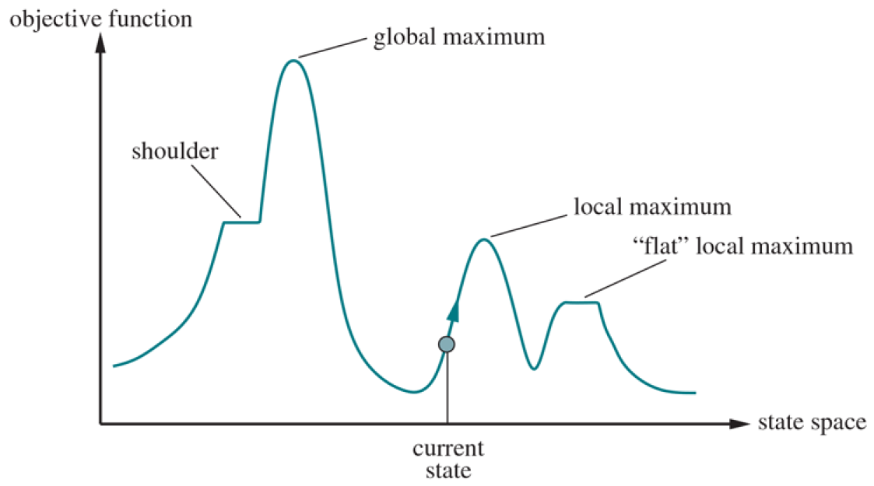
Local Search
Each point (state) in the landscape has an “elevation,” defined by the value of the objective function.
If elevation corresponds to an objective function, then the aim is to find the highest peak—a global maximum—and we call the process hill climbing.
If elevation corresponds to cost, then the aim is to find the lowest valley—a global minimum—and we call it gradient descent.
A one-dimensional state-space landscape in which elevation corresponds
to the objective function. The aim is to find the global maximum.

Slide 5
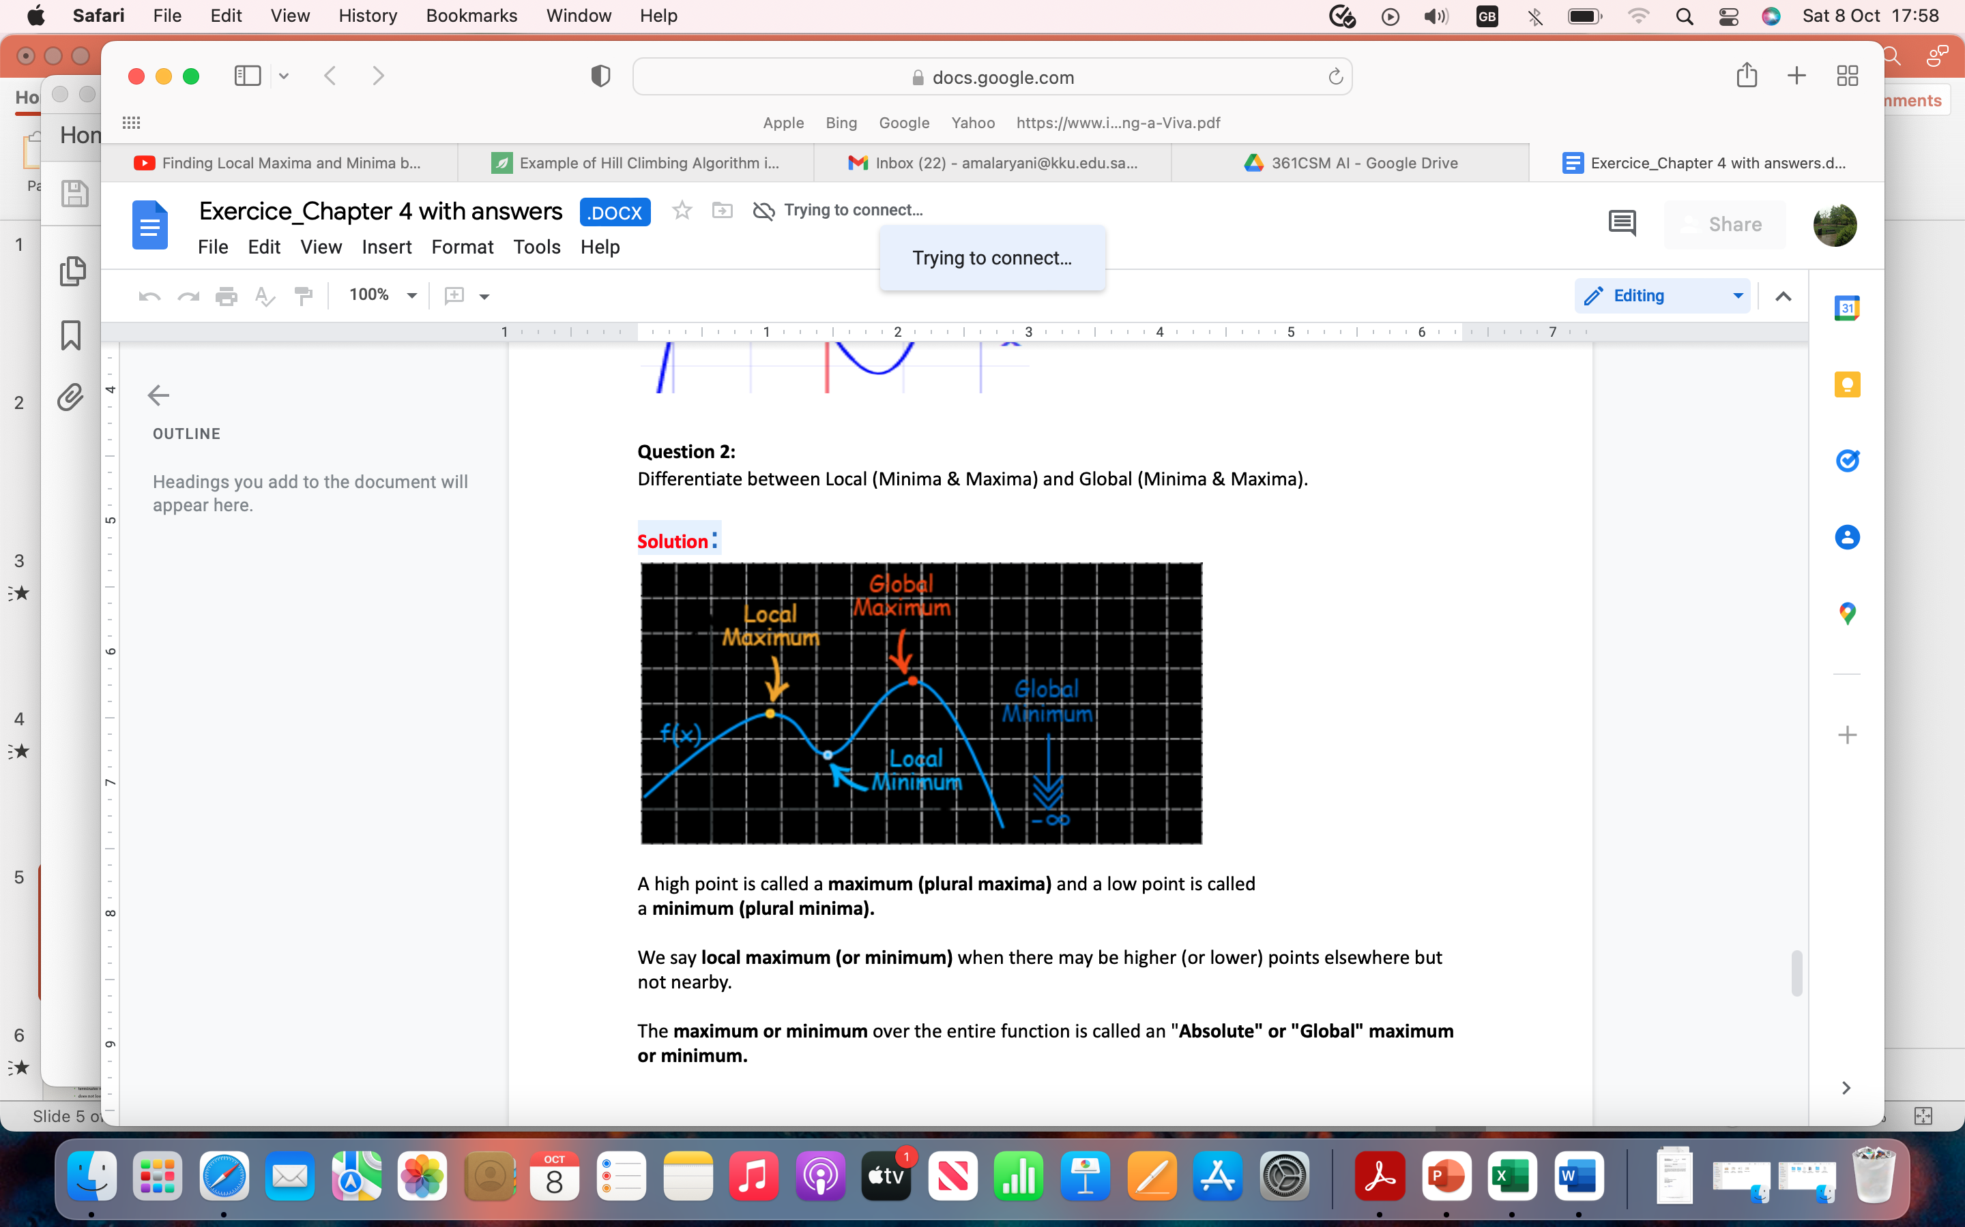
Terminologies
A high point is called a maximum (plural maxima).
A low point is called a minimum (plural minima).
We say local maximum (or minimum) when
there may be higher (or lower) points
elsewhere but not nearby.
The maximum or minimum over the entire
function is called an "Absolute" or "Global"
maximum or minimum.

Slide 6
Example
Find the maxima and minima for a function:
y = 5x³ + 2x² − 3x (1)
Solution:
Apply first derivative to equation (1)
y’ = 15x² + 4x – 3 (2)
Find the value of x
15x²+9x-5x−3=0
3x(5x+3)-1(5x+3)=0 using factorization
(3x-1)(5x+3)=0
x=1/3, x=-3/5
At x=1/3:
y’=15(1/3)² +4(1/3) – 3 = 0
At x=-3/5:
y’= 15(-3/5)² +4(-3/5) – 3 = 0

Slide 7
Example
Apply derivative once more to equation (2), the second derivative
y'' = 30x + 4 (3)
At x = −3/5:
y'' = 30(−3/5) + 4 = −14
it is less than 0, so −3/5 is a local maximum At x = +1/3:
y'' = 30(+1/3) + 4 = +14
it is greater than 0, so +1/3 is a local minimum

Slide 8
Hill-Climbing Search
The hill-climbing search algorithm keeps track of one current state and on each iteration moves to the neighbouring state with highest value.
heads in the direction that provides the steepest ascent.
terminates when it reaches a “peak” where no neighbour has a higher value.
does not look ahead beyond the immediate neighbours of the current state.
one way to use hill-climbing search is to use the negative of a heuristic cost function as the objective function; that will climb locally to the state with smallest heuristic distance to the goal.
sometimes called greedy local search because it grabs a good neighbour state without thinking ahead about where to go next.

Slide 9
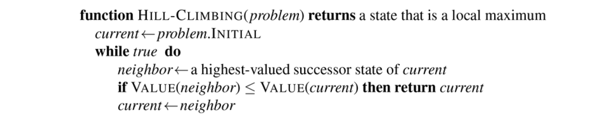
Hill-Climbing Search
The hill-climbing search algorithm, which is the most basic local search technique. At each step the current node is replaced by the best neighbour.

Slide 10
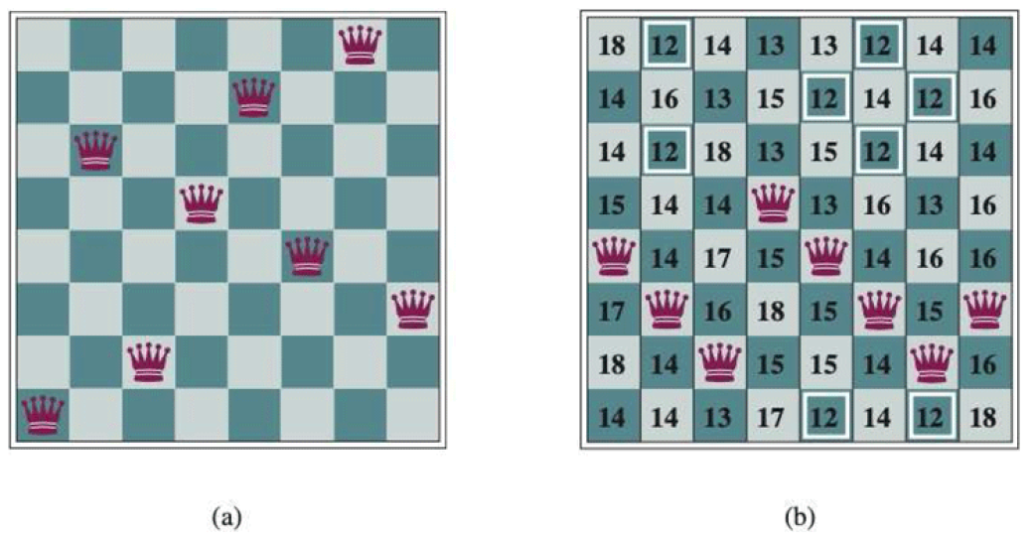
Example
8 Queens
The goal is to minimize the number of queens attacking each other.
Heuristic cost estimate, h=number of queens (Q) attacking each others directly or indirectly.
Successors are all possible states
moving one Q in the same column.
8 * 7= 56 possible successors.
(a) h=1
(b) h= 17

Slide 11
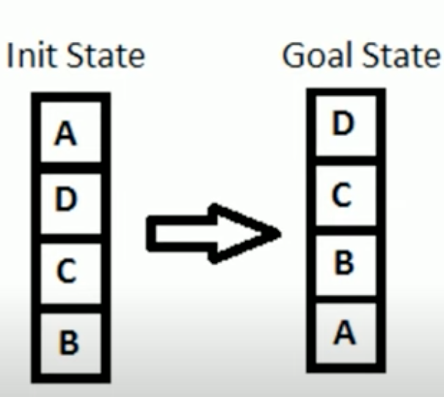
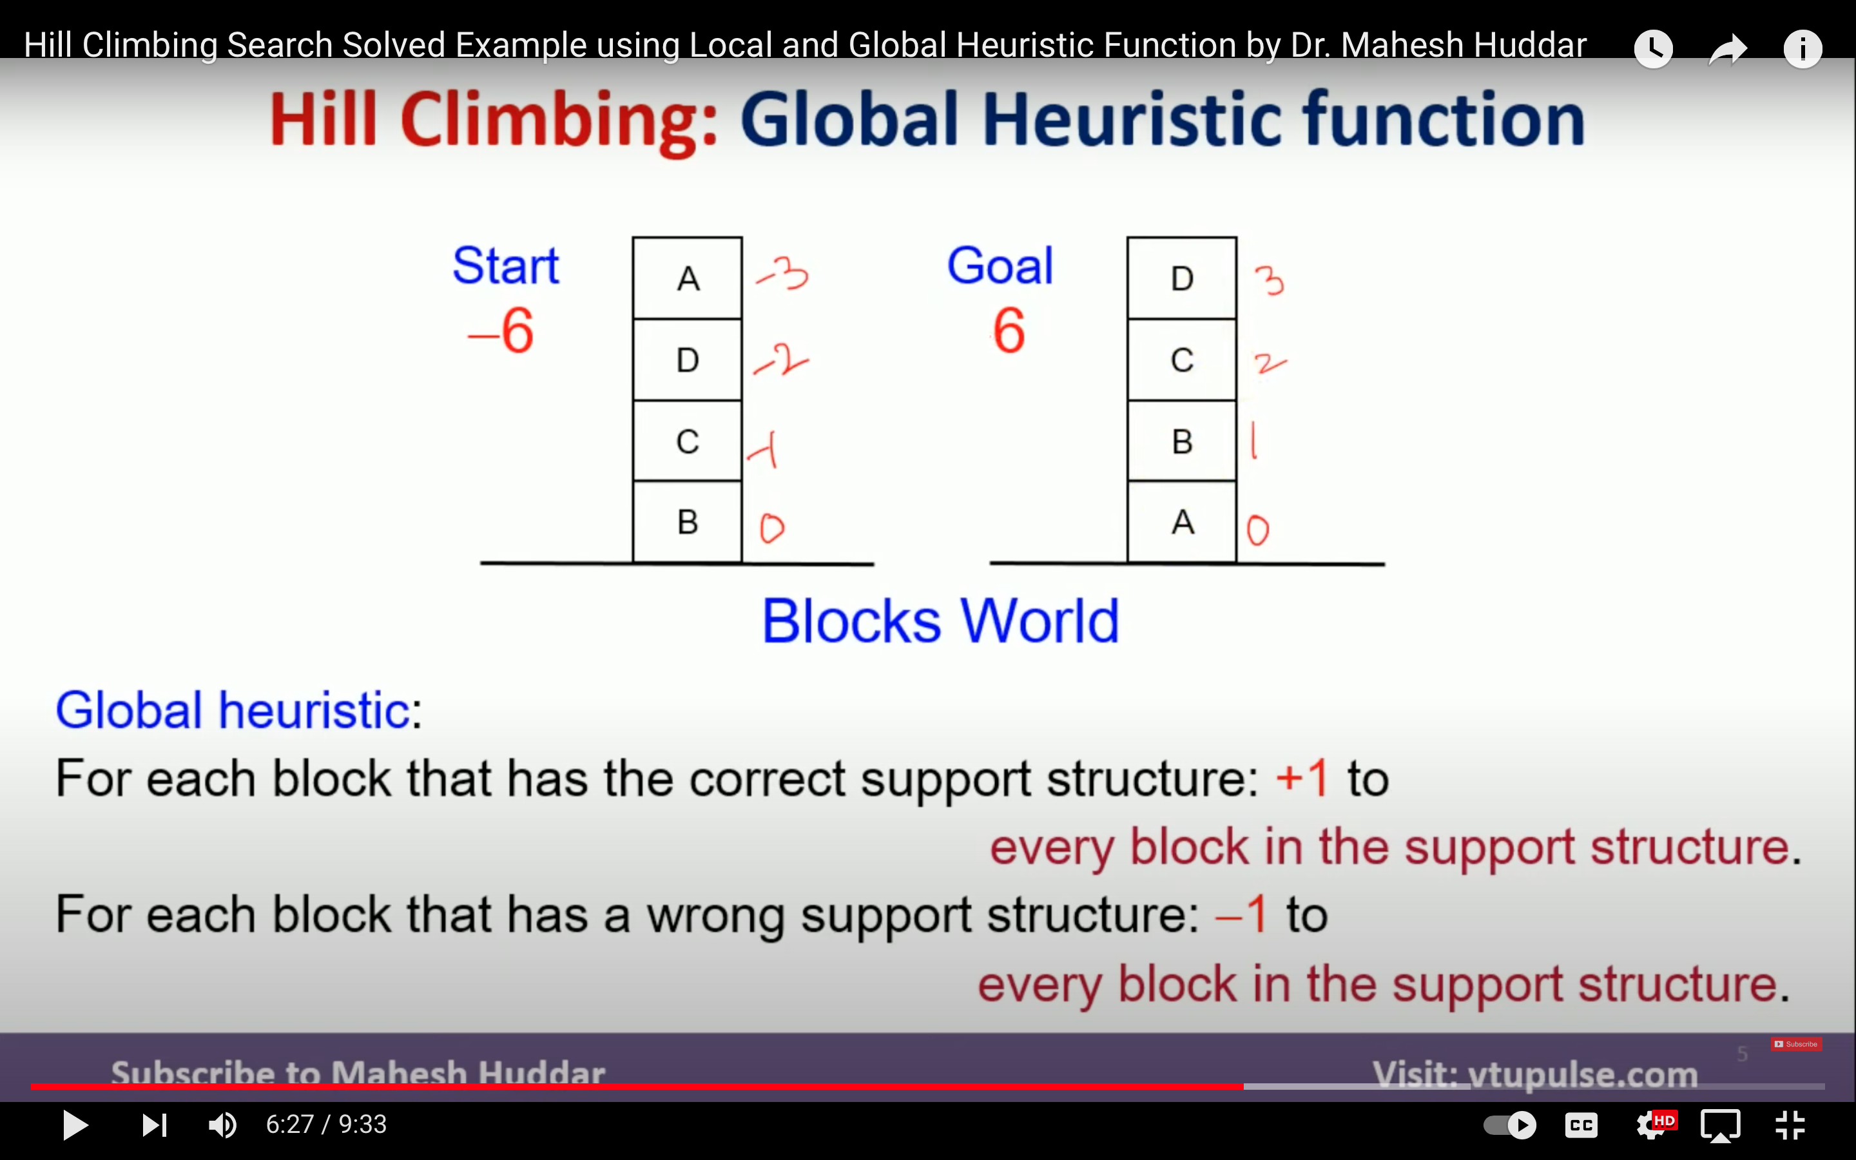
Example
4-Blocks: global heuristic function
h= +1 for all the blocks in the support structure if the block is correctly positioned
otherwise h= -1

Slide 12
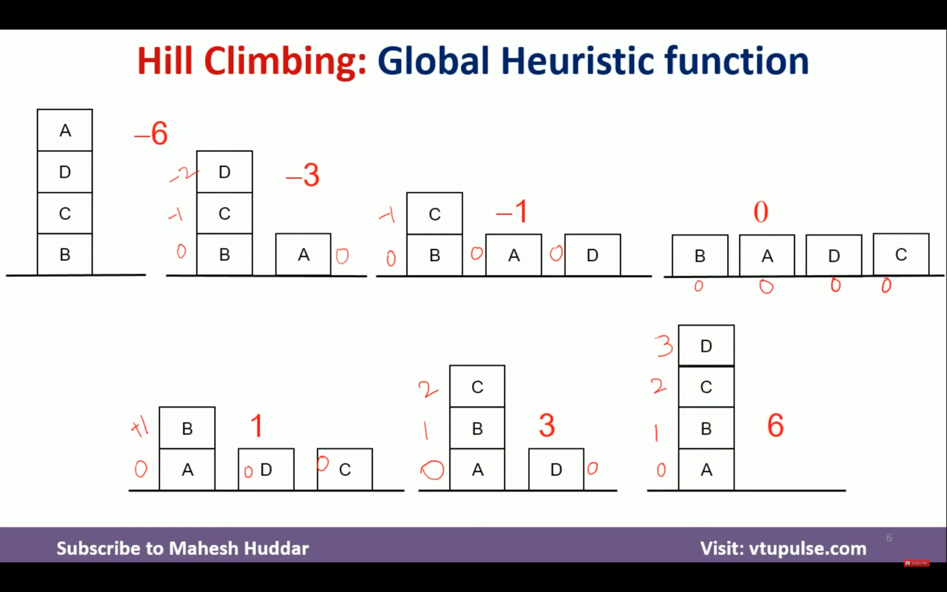
Example
Start with h= -6
(1)
(2)
(3)
(4)
(5)
(6)
(7)
End with h=-6

Slide 13
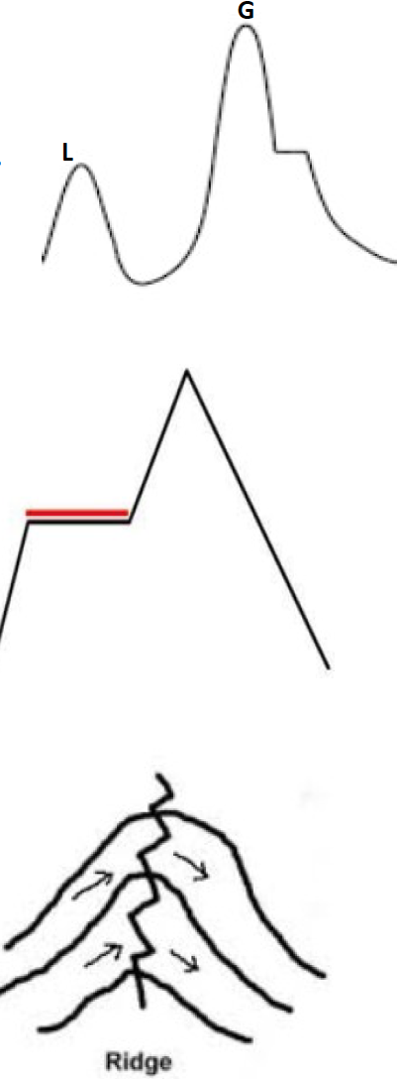
Hill-Climbing Search Pros/Cons
Pros:
It can make rapid progress toward a solution because it is usually quite easy to improve a bad state.
No backtracking
Cons:
LOCAL MAXIMA: a peak that is higher than each of its neighbouring states but lower than the global maximum.
PLATEAUS: a flat area of the state-space landscape. It can be
a flat local maximum, from which no uphill exit exists, or a
shoulder, from which progress is possible.
RIDGES: result in a sequence of local maxima that is very difficult for greedy algorithms to navigate.

Slide 14
Hill Climbing Types
Stochastic hill climbing
chooses at random from among the uphill moves
the probability of selection can vary with the steepness of the uphill move
converges more slowly than steepest ascent
finds better solutions in some state
First-choice hill climbing
implements stochastic hill that generates successors randomly until one is generated that is better than the current state
a good strategy when a state has many (e.g., thousands) of successors.
Random-restart hill climbing
conducts a series of hill-climbing searches from randomly generated initial states, until a goal is found
complete with probability 1, because it will eventually generate a goal state as the initial state

Slide 15
Simulated Annealing
Key Idea: escape local maxima by allowing some "bad" moves but gradually decrease their frequency
Take some uphill steps to escape the local minimum
Instead of picking the best move, it picks a random move
If the move improves the situation, it is executed. Otherwise, move with some probability less than 1.
Physical analogy with the annealing process:
Allowing liquid to gradually cool until it freezes
The heuristic value is the energy, E
Temperature parameter, T, controls speed of convergence.

Slide 16
Simulated Annealing
Basic inspiration: What is annealing?
In mettallurgy, annealing is the physical process used to temper or harden metals or glass by heating them to a high temperature and then gradually cooling them, thus allowing the material to coalesce into a low energy cristalline state.
Heating then slowly cooling a substance to obtain a strong cristalline structure.
Key idea: Simulated Annealing combines Hill Climbing with a random walk in some way that yields both efficiency and completeness.
Used to solve VLSI layout problems in the early 1980

Slide 17
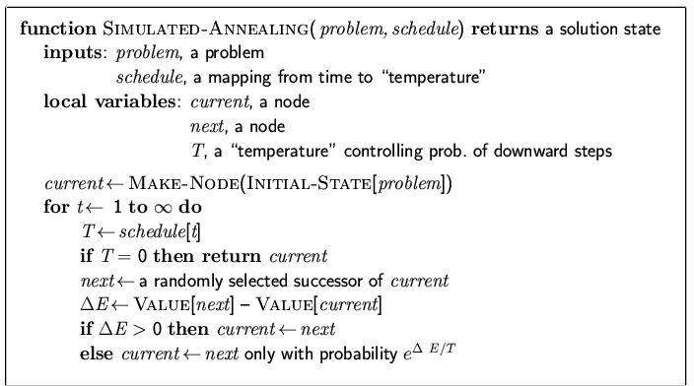
Simulated Annealing

Slide 18
Simulated Annealing
Temperature T
Used to determine the probability
High T : large changes
Low T : small changes
Cooling Schedule
Determines rate at which the temperature T is lowered
Lowers T slowly enough, the algorithm will find a global optimum
In the beginning, aggressive for searching alternatives, become conservative when time goes by

Slide 19
Simulated Annealing
Cost
Best
States

Slide 20
Simulated Annealing
Cost
Best
States

Slide 21
Simulated Annealing
Cost
Best
States

Slide 22
Simulated Annealing
Cost
Best
States

Slide 23
Simulated Annealing
Cost
Best
States

Slide 24
Simulated Annealing
Cost
Best
States

Slide 25
Simulated Annealing
Cost
Best
States

Slide 26
Simulated Annealing
Cost
Best
States

Slide 27
Simulated Annealing
Cost
Best
States

Slide 28
Simulated Annealing
Cost
Best
States

Slide 29
Simulated Annealing
Cost
Best
States

Slide 30
Simulated Annealing
Cost
Best
States

Slide 31
Simulated Annealing
Cost
Best
States

Slide 32
Simulated Annealing
Cost
Best
States

Slide 33
Simulated Annealing
Cost
Best
States

Slide 34
Simulated Annealing
Cost
Best
States

Slide 35
Simulated Annealing
Cost
Best
States

Slide 36
Simulated Annealing
Cost
Best
States

Slide 37
Simulated Annealing
Cost
Best
States

Slide 38
Simulated Annealing
Cost
Best
States

Slide 39
Simulated Annealing
Cost
Best
States

Slide 40
Simulated Annealing
Cost
Best
States

Slide 41
Simulated Annealing
Cost
Best
States

